Slide 1

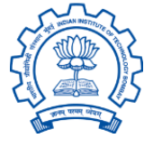
Cloud Computing Labs:
Docker &
Serverless Framework
Soumik Dutta (23M0826)
guided by
Prof. Kameswari Chebrolu
MTP 1 Presentation

Slide 2
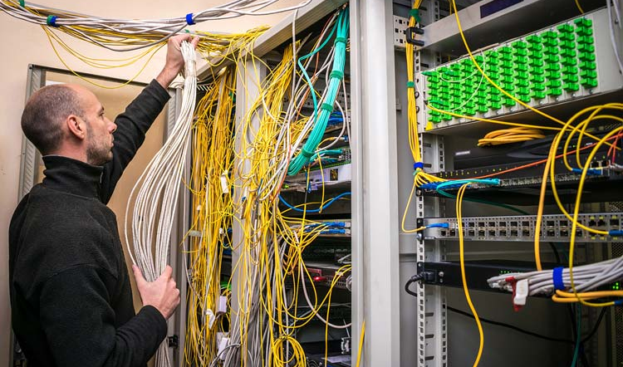

Motivation
Cloud computing has transformed how modern systems are built.
Shift to microservices, containerization, and serverless architectures
Growing need for hands-on learning beyond theoretical knowledge
The Cloud Computing Lab bridges this gap:
Structured, real-world exercises
Focus on experiment, debugging, reasoning
On-prem server
Cloud computing

Slide 3

Objectives
Design & implement modular lab activities
Demonstrating Docker and Serverless Framework (FaaS)
Ensure reproducibility via containerized execution in cLab platform
Develop autograder scripts
Document complete workflows — setup, execution, and verification for each lab

Slide 4
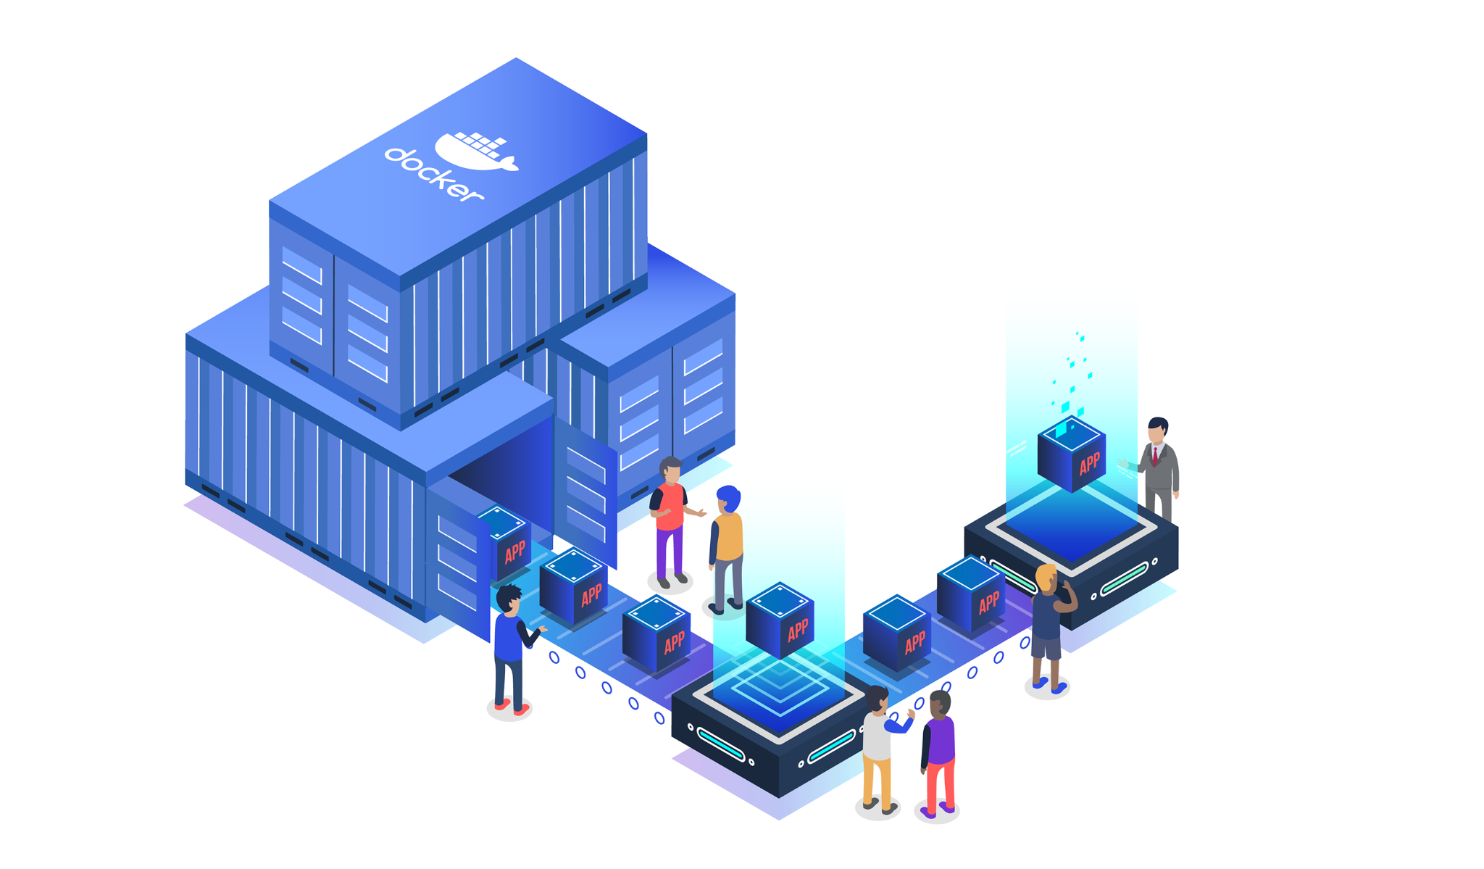
Platform Architecture

Slide 5


Instructor Workflow
BodhiTree
Create/Edit Lab
MetaData
Files and Script
DockerFile
Lab metadata
Lab files
Env. setup file (Dockerfile)
Evaluation Scripts
Save in DB
Build
Save In Storage
Image
Push
Docker Image Repository

Slide 6

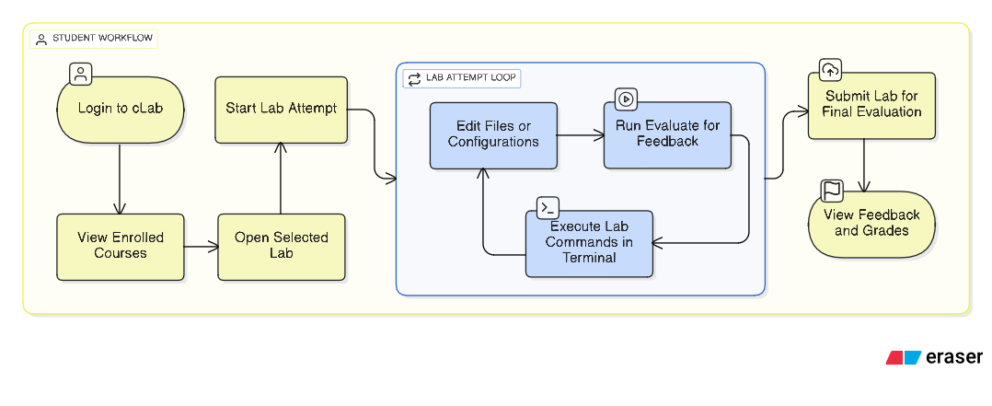

Student Workflow
cLab

Slide 7
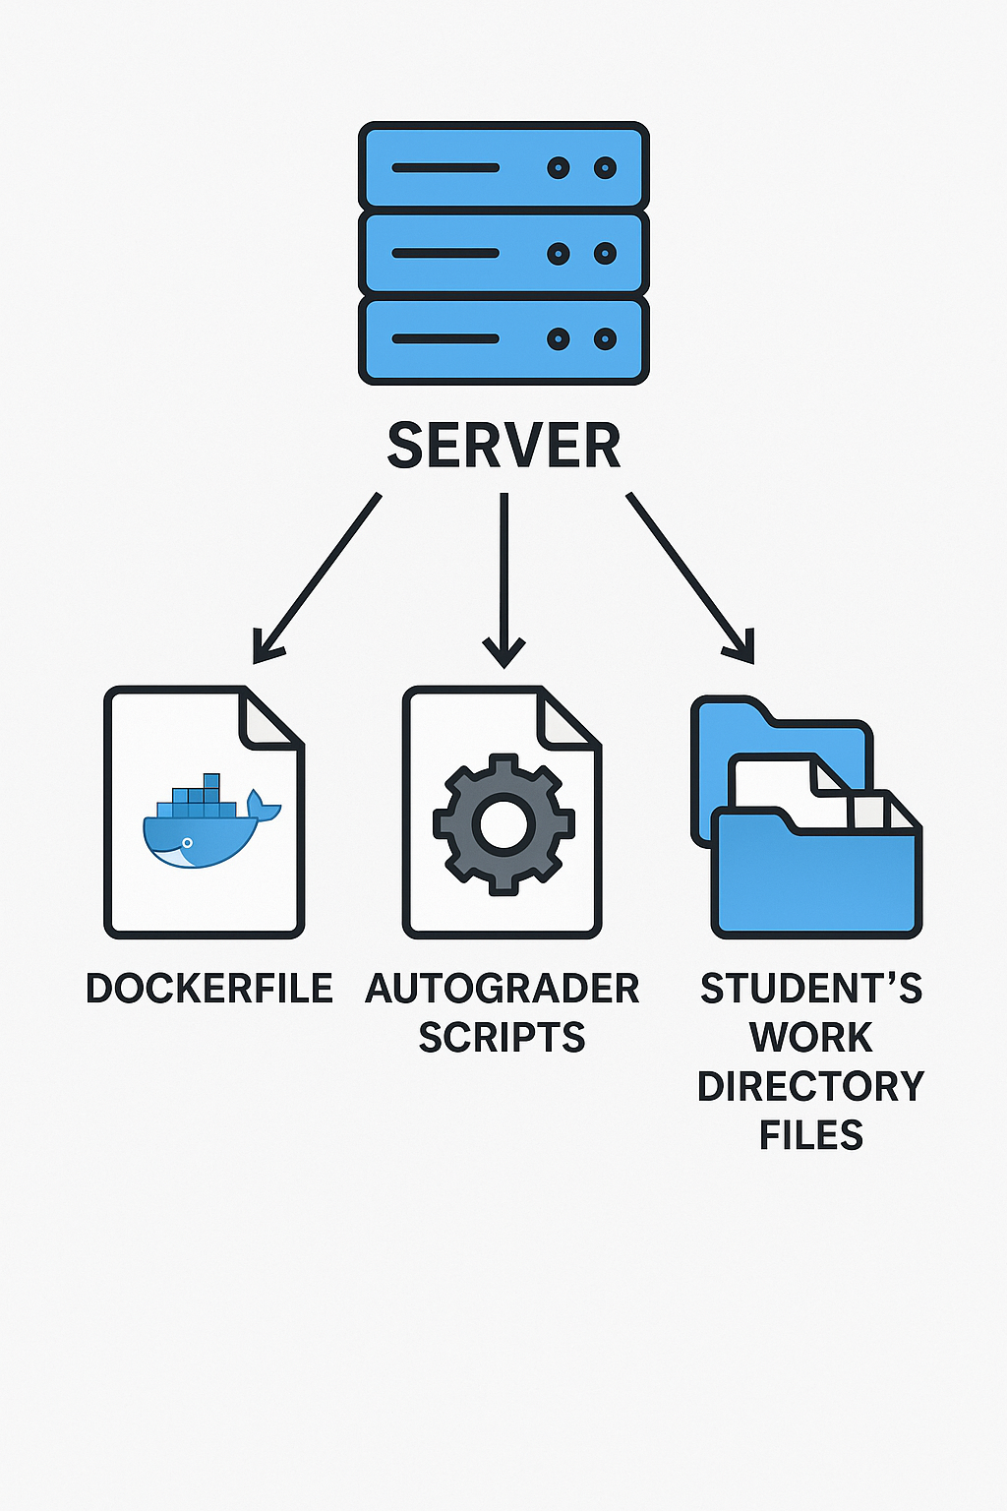
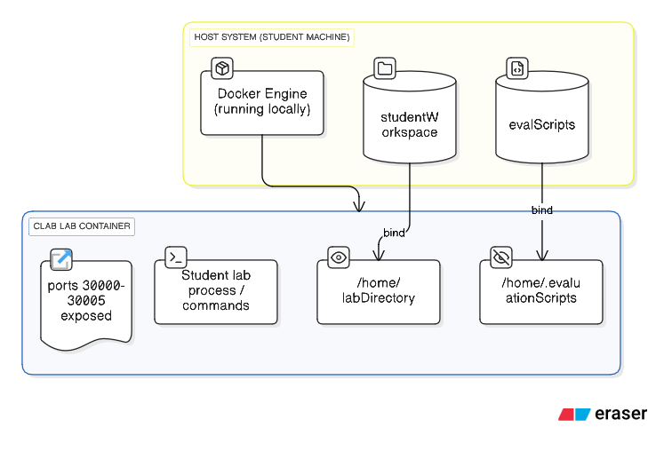
cLab / BodhiTree
BodhiTree
cLab

Slide 8
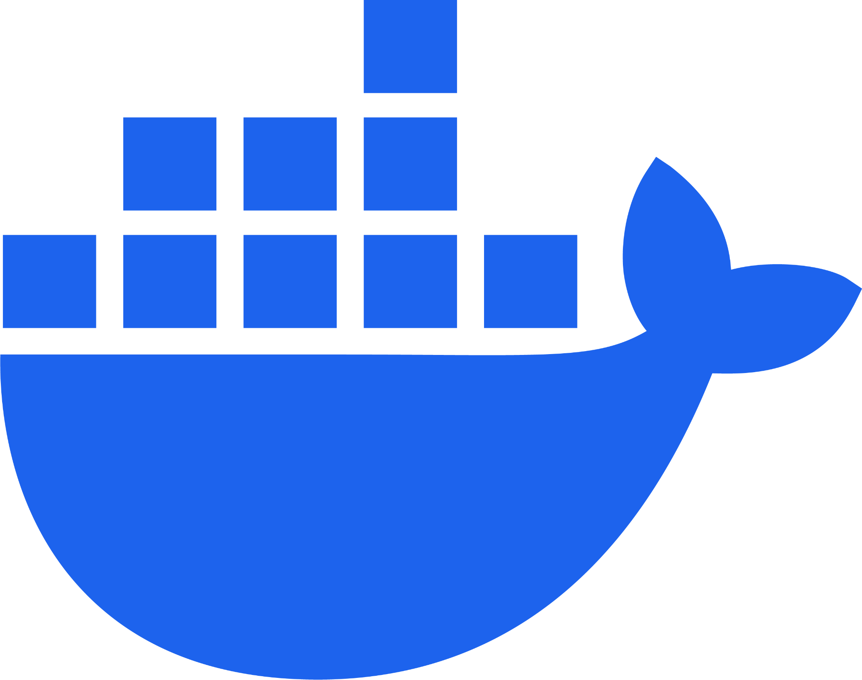
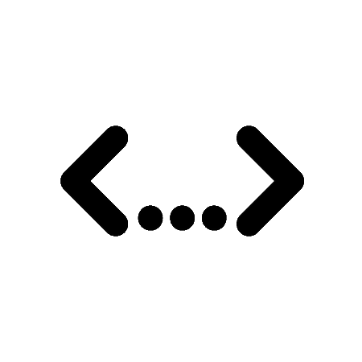

Project Outline
About Docker
Docker Labs
About Serverless Framework
Serverless Labs
Activity
0
Activity
1
Activity
7
Activity
1
Activity
4

Slide 9
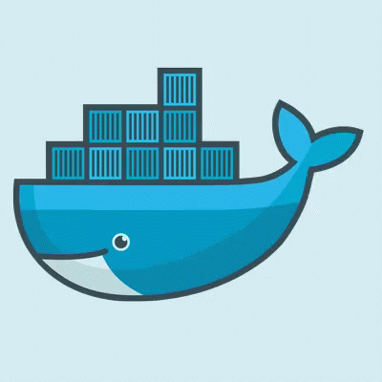
About Docker

Slide 10
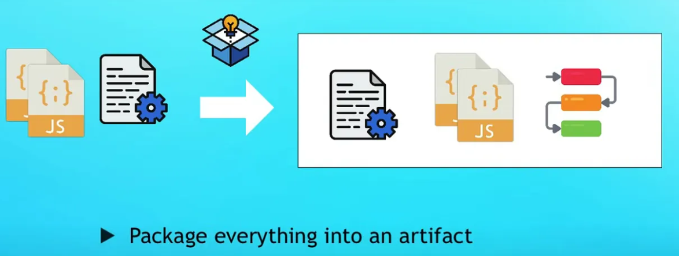
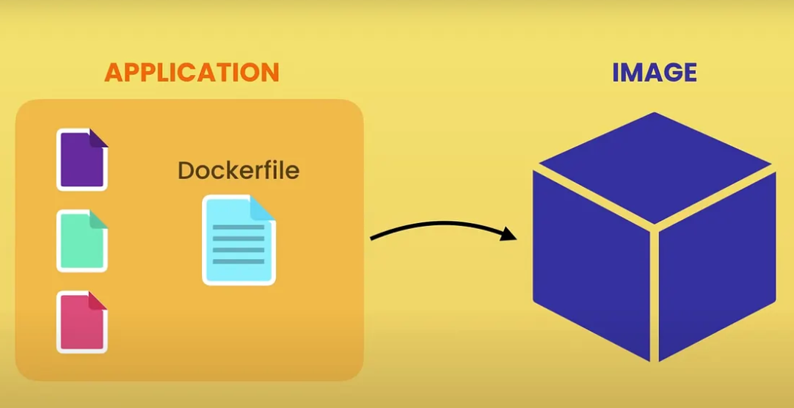

What is Docker?
A containerization platform
Packages application with all its dependencies into isolated unit.
Ensures application runs identically on any environment: laptop, server, cloud. 🪶 Lightweight: share host OS kernel
🚀 Portable: run anywhere
♻️ Reproducible: consistent builds, runs

Slide 11
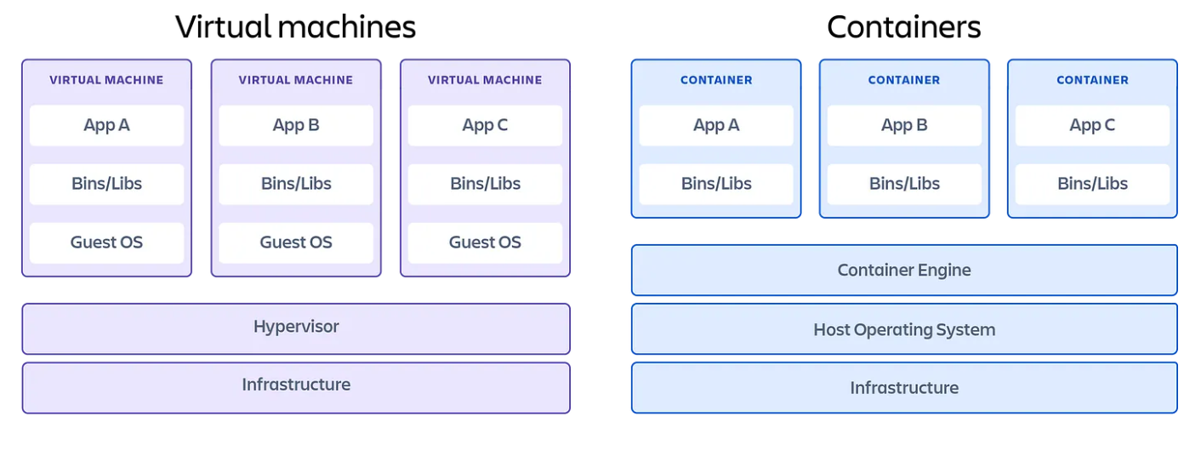
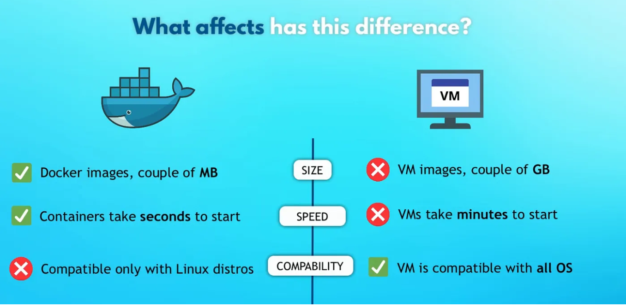
Why Docker?
Traditional Virtual Machines:
Each VM runs its own guest OS.
Docker Containers:
Share the host kernel for process isolation
Use namespaces and cgroups for lightweight separation

Slide 12
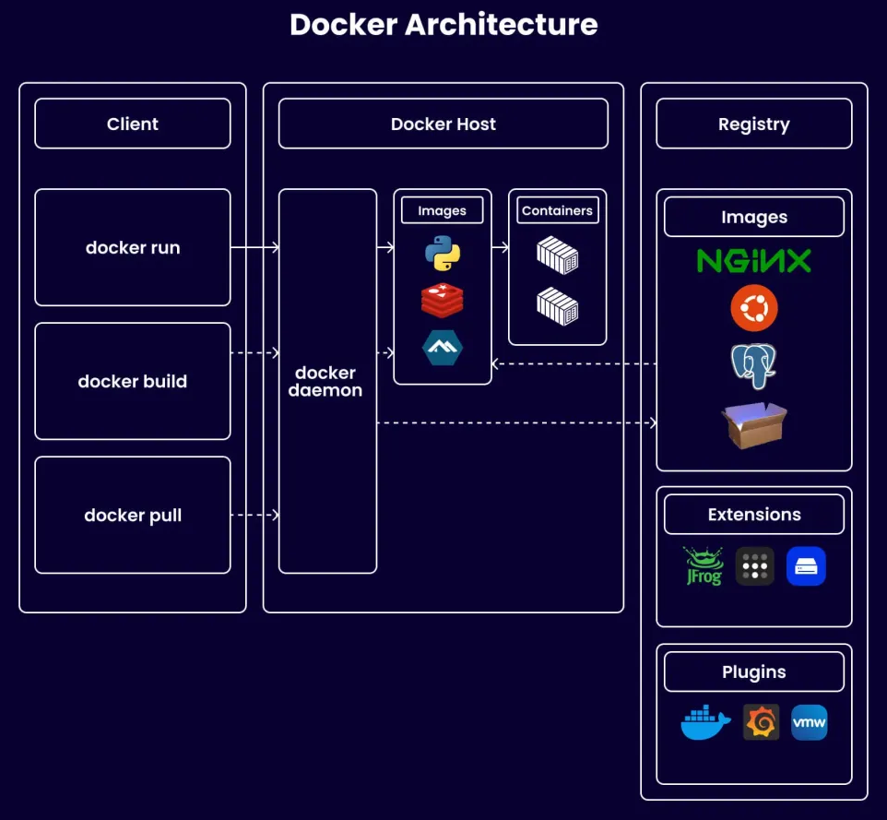
Docker Architecture 1
Follows a client-server model
Docker Client: CLI or REST API for user commands
Docker Daemon (dockerd): Builds, runs, and manages containers
Docker Images: Read-only templates built from Dockerfiles
Docker Containers: Runtime instances of images
Docker Registry: Central store for images (e.g., Docker Hub)
Docker Engine: Combines client + daemon + APIs

Slide 13
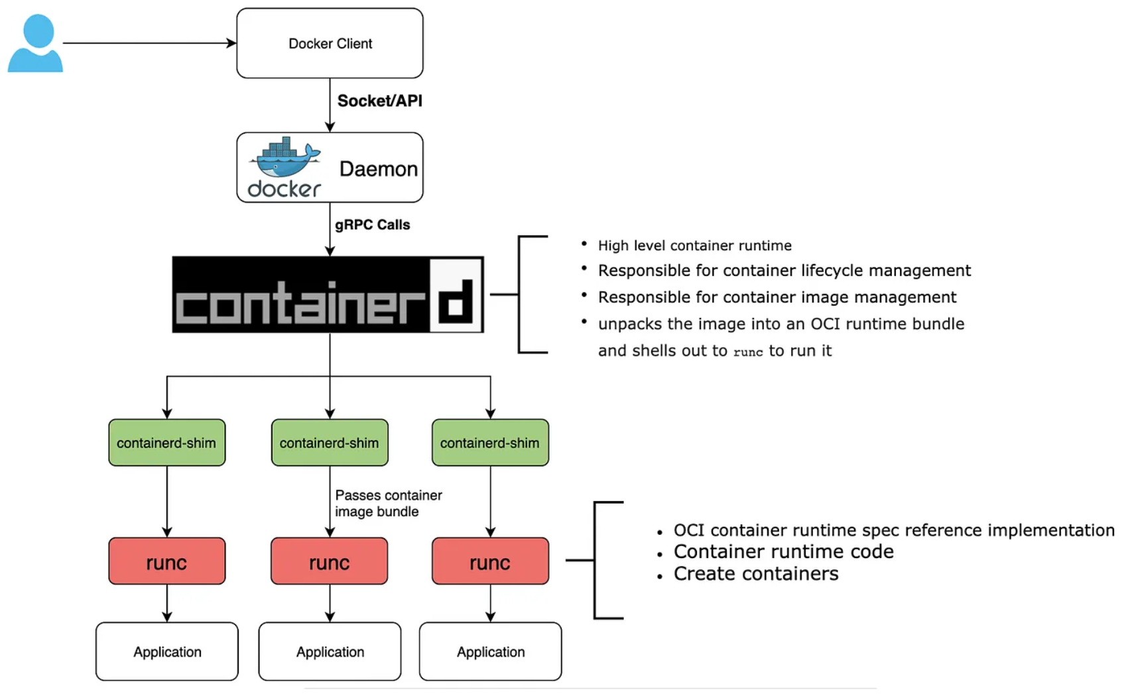
Docker Architecture 2
Containerd: container manager, responsible for container lifecycle and image management
dockerd: High level container runtime
containerd-shim: abstract low-level runtime operations
runc: command-line tool that complies with the OCI runtime specification to create and run containers

Slide 14
Project Outline
About Docker
Docker Labs
About Serverless Framework
Serverless Labs
Activity
0
Activity
1
Activity
7
Activity
1
Activity
4

Slide 15


Docker Labs

Slide 16
Activity 0
Environment Setup

Slide 17
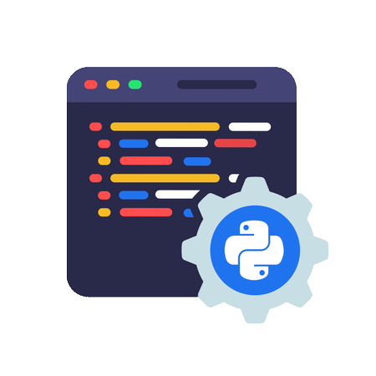

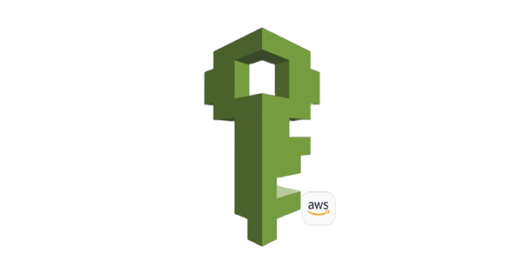
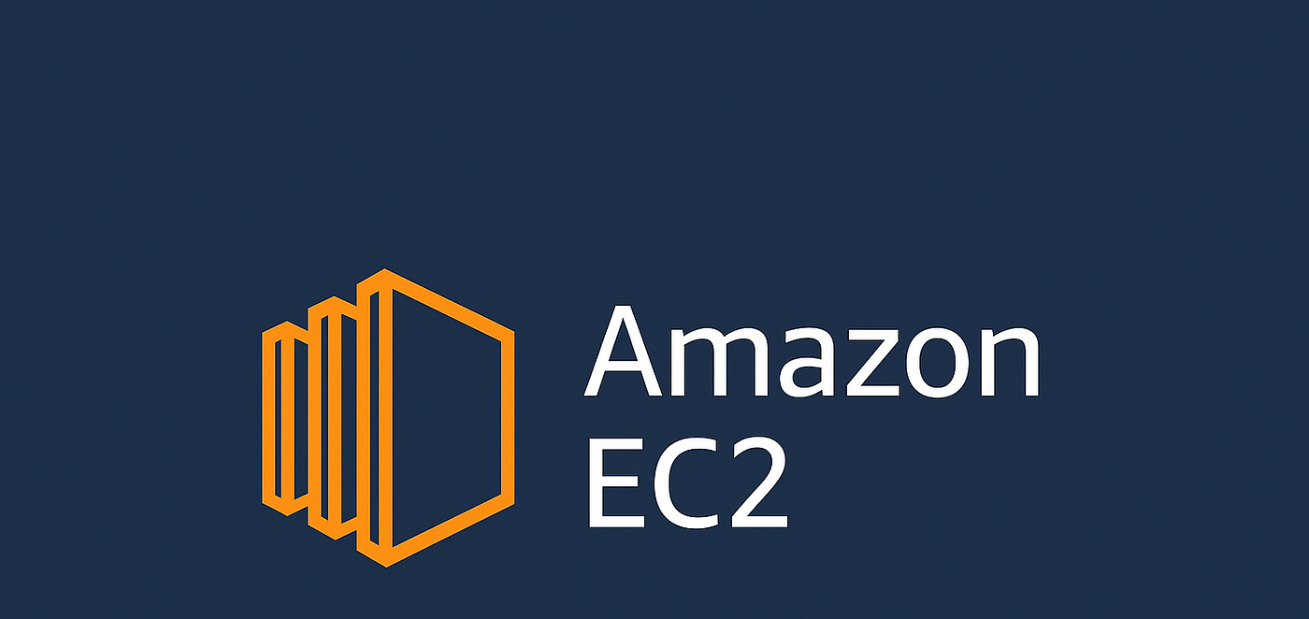
Purpose
🎯To establish a reproducible cloud-based development environment for all Docker Labs.
Provision an Ubuntu 24.04 EC2 instance on AWS as the base VM.
Install and verify Docker Engine.
Implement IAM access based CLI integration for secure SSH connectivity.
Autograder utilize this secure SSH mechanism to automate autograding in subsequent activities.
IAM secret-key.pem
Autograder python script

Slide 18

Implementation Challenges
Added step-by-step screenshots of each AWS console to make the setup beginner-friendly.
Instructed students to apply chmod 400 on the SSH key for secure, read-only access.
Provided a complete, sequential Docker installation guide for clarity and self-learning.
Developed autograder script to verify setup correctness and eliminate environment inconsistencies for future labs.

Slide 19
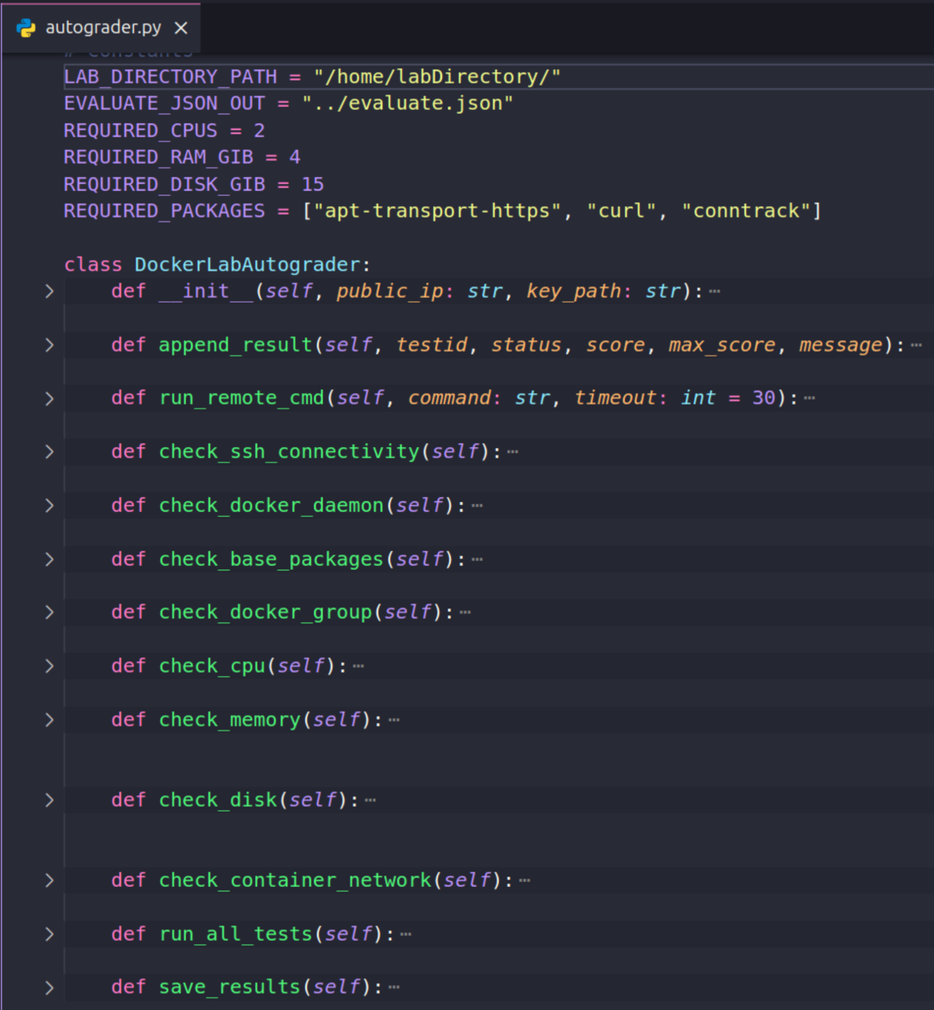
Autograder
Python-based autograder integrated with cLab.
Modular, OOP-based design - for easy debugging and future maintenance.
Separate modules for:
🔑 SSH & key permission check
🧱 Base package check
🐳 Docker installation
📂 User/group permission check
⚙️ CPU, memory, disk validation
🌐 Container networking check
Reusable framework for all future Docker labs.

Slide 20
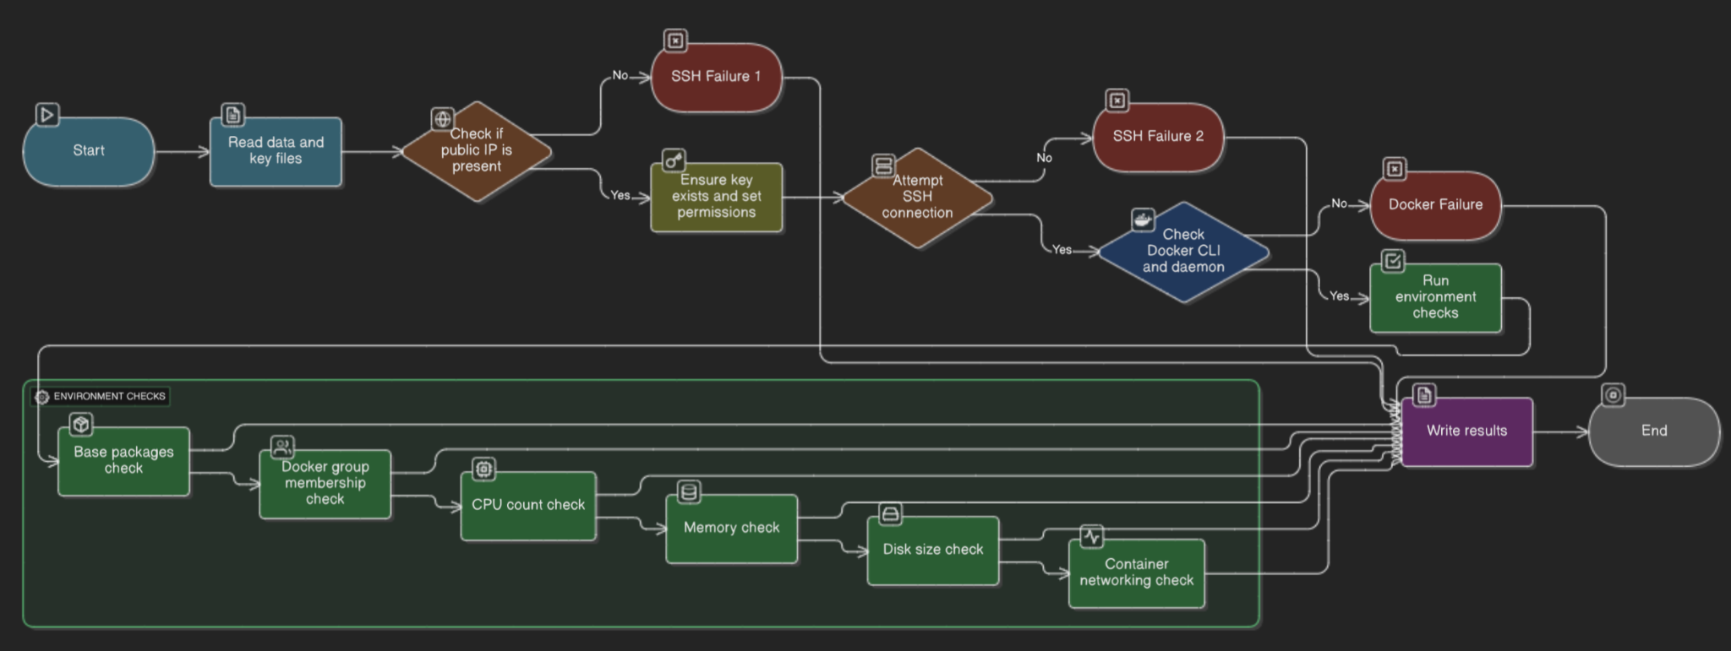
Autograder States

Slide 21
Activity 1
Core Docker Operations

Slide 22
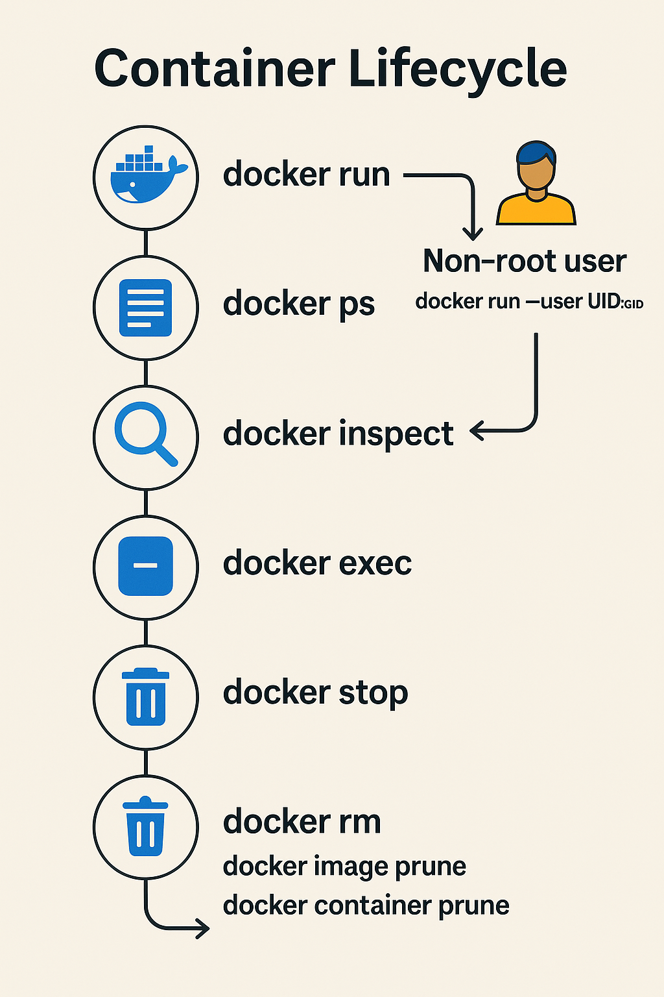
Purpose
🎯To provide hands-on experience with Docker CLI, focusing on container lifecycle, inspection, and security best practices
Run & Manage: Create, control, and configure containers in detached and interactive modes.
Inspect & Monitor: Extract specific metadata and monitor live resource usage.
Secure Containers: Run processes as a non-root user to minimize security risks.
Maintain Hygiene: Efficiently clean up unused images, containers, and volumes with docker prune.

Slide 23
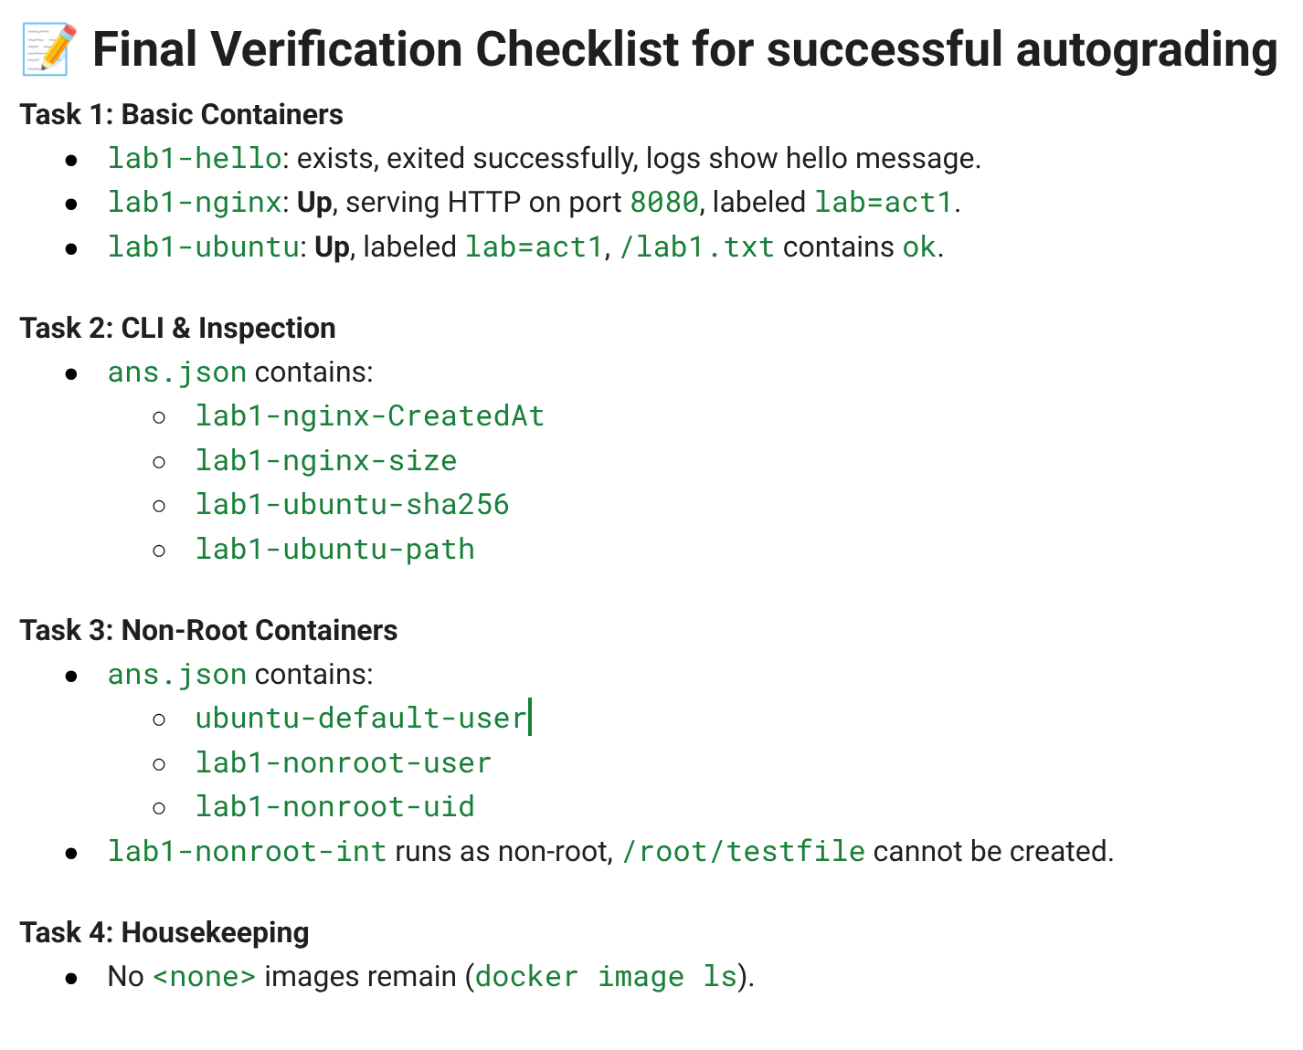
Implementation Challenges
A four-part guided lab using official images (nginx, ubuntu) to simulate real-world scenarios
Challenge: Dynamic Container States
Solution: Implemented retry logic and stateful inspect checks to await a stable state before grading.
Challenge: Verifying Non-Root Privileges
Solution: Combined docker exec id (in-container) with docker top (host-level).
Challenge: Command Overload for Students
Solution: Added concise command summary tables at end of the each tasks.

Slide 24
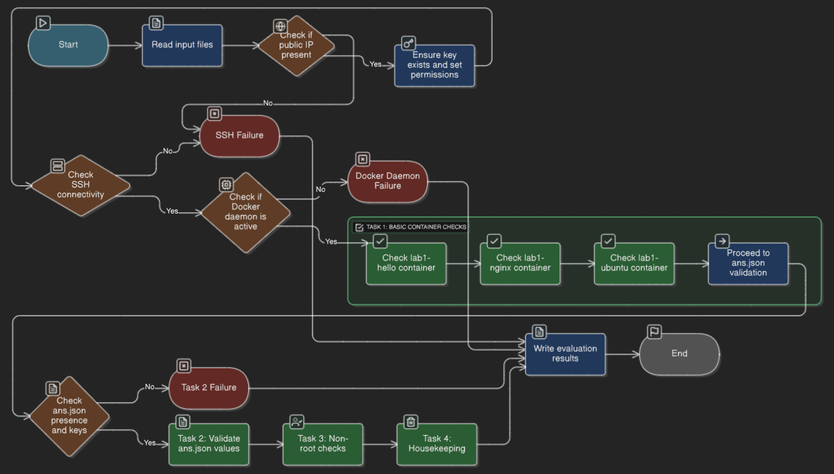
Autograder

Slide 25
Activity 2
Docker Image Lifecycle & Persistence

Slide 26
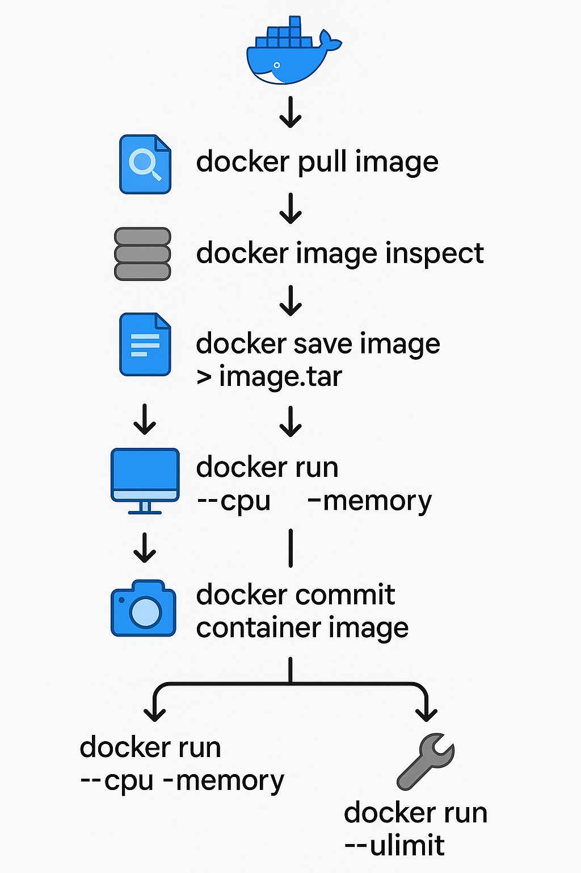
Purpose
🎯To master image management, data persistence for production-like container deployments.
Image Lifecycle: inspect metadata, analyze history, save/load images, and commit changes from containers.
Runtime Controls: Apply health checks, CPU/memory limits, and ulimits to govern container behavior.
Data Persistence: Understand and implement volumes, bind mounts, and tmpfs for stateful applications.
Practical Application: Use a MySQL database to demonstrate data persistence across container restarts.

Slide 27
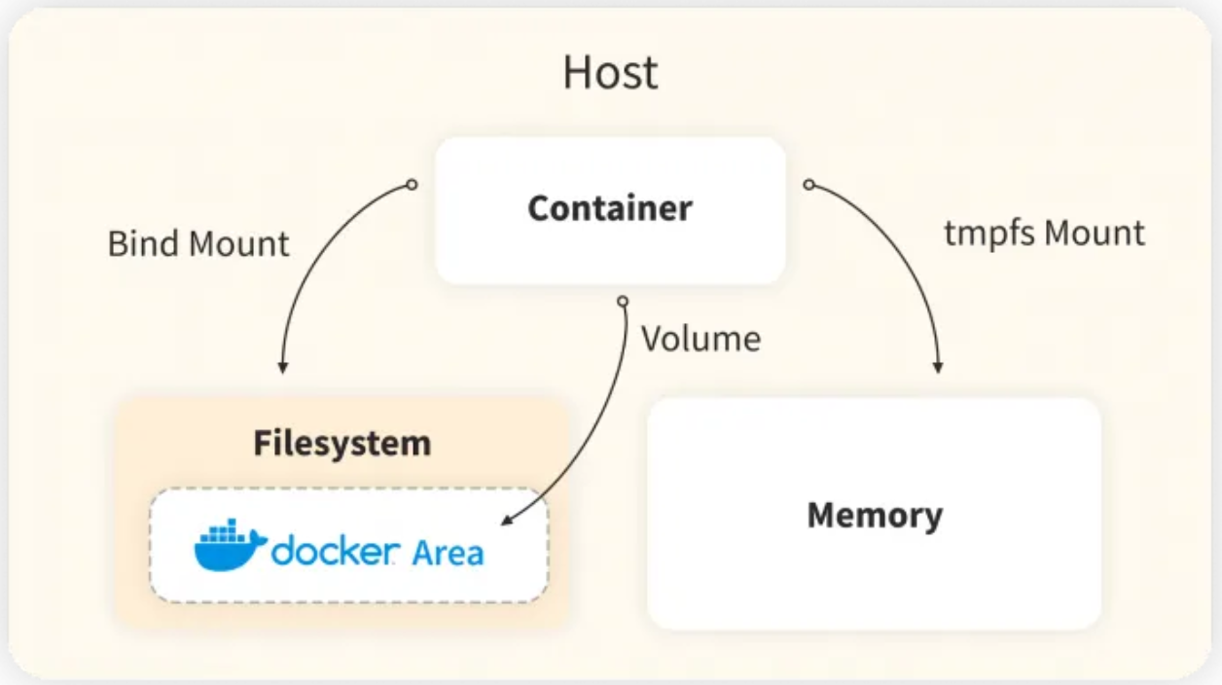
Data Persistence
Volumes (Preferred for Production):
What: Docker-managed storage, decoupled from the host filesystem.
Why: Best for databases and stateful data. Portable, secure, and easy to back up. Data survives container removal.
Bind Mounts:
What: Maps a host directory directly into container.
Why: Useful for development when you need to edit code on the host live. Less portable.
tmpfs Mounts:
What: Stores data in the host's RAM.
Why: Extremely fast for temporary, non-critical data. Data is lost when the container stops.

Slide 28
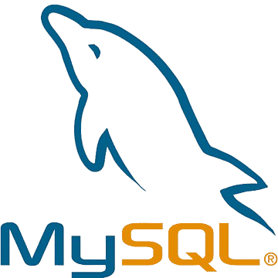
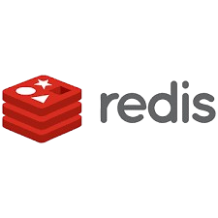
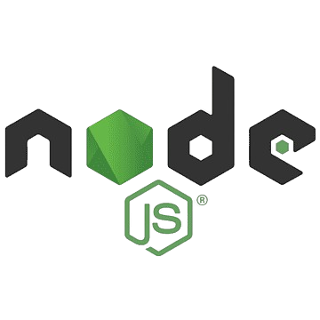
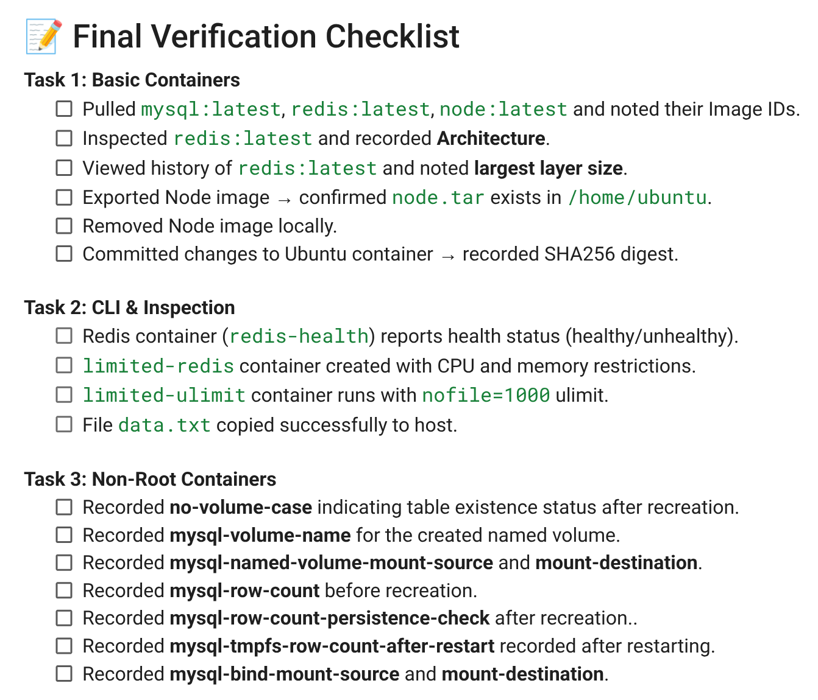
Implementation Challenges
A three-part lab using MySQL, Redis, and Node.js images to explore image management, resource constraints, and storage strategies.
Challenge: Slow MySQL startup
Solution: health-check + retry loops.
Challenge: Large image tar sizes filling disk
Solution: recommend compression + prune temp tars.
Challenge: Concept of Volume is little confusing to beginners.
Solution: Kept hands on demos for each types with clear description of use cases.

Slide 29
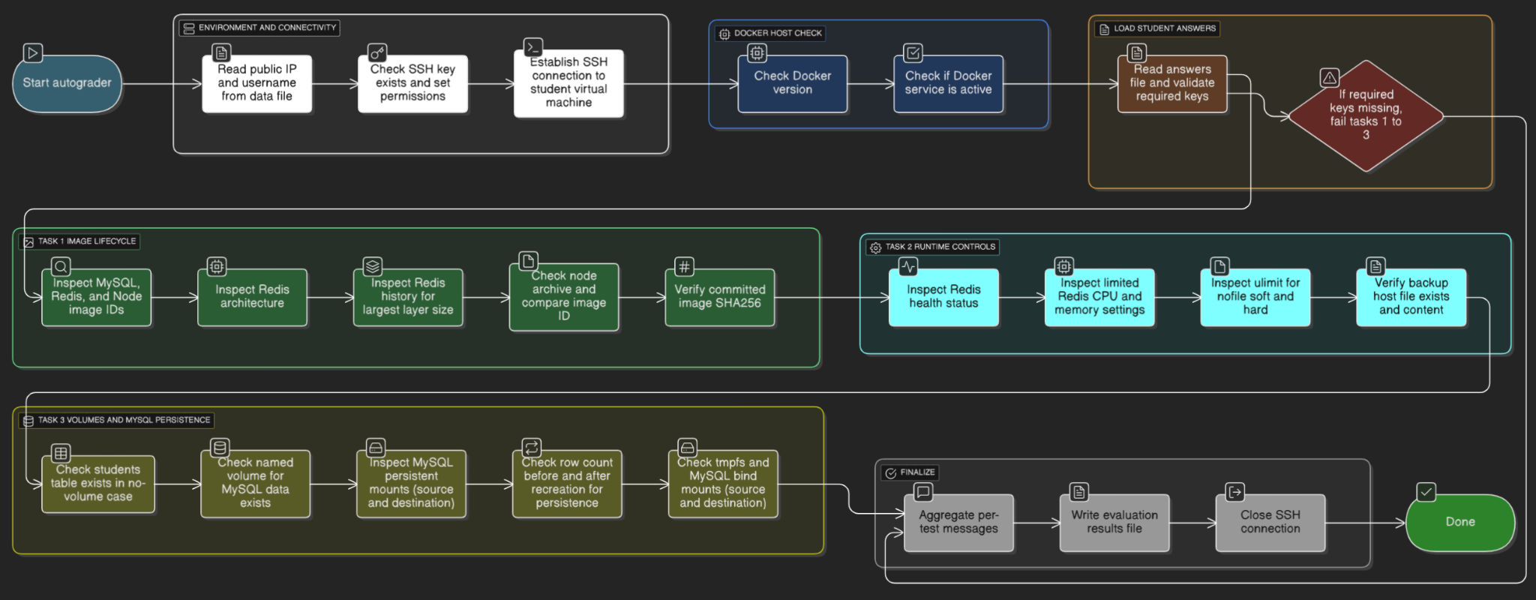
Autograder

Slide 30
Activity 3
Building and Publishing Custom Docker Images

Slide 31

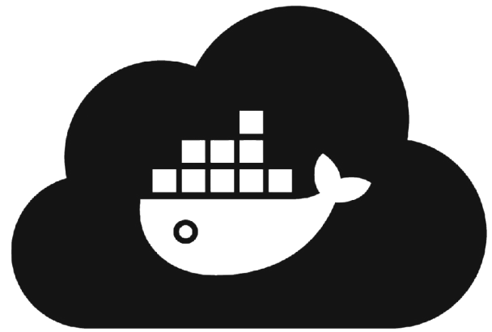


Purpose
GET /api/products
GET /health
GET /logo
🎯Containerize a Flask REST API by building an optimized docker image from scratch publishing it to Docker Hub.
Understand and apply: Instructions like FROM, RUN, COPY/ADD, ENV, WORKDIR, USER, EXPOSE, HEALTHCHECK, ENTRYPOINT/CMD.
Build & Test Locally: Compile a custom image, tag it, and validate its functionality by running it as a container.
Publish & Distribute: Push the final, tested image to a public registry (Docker Hub) for sharing and deployment.
Push
Pull
GET /logo

Slide 32
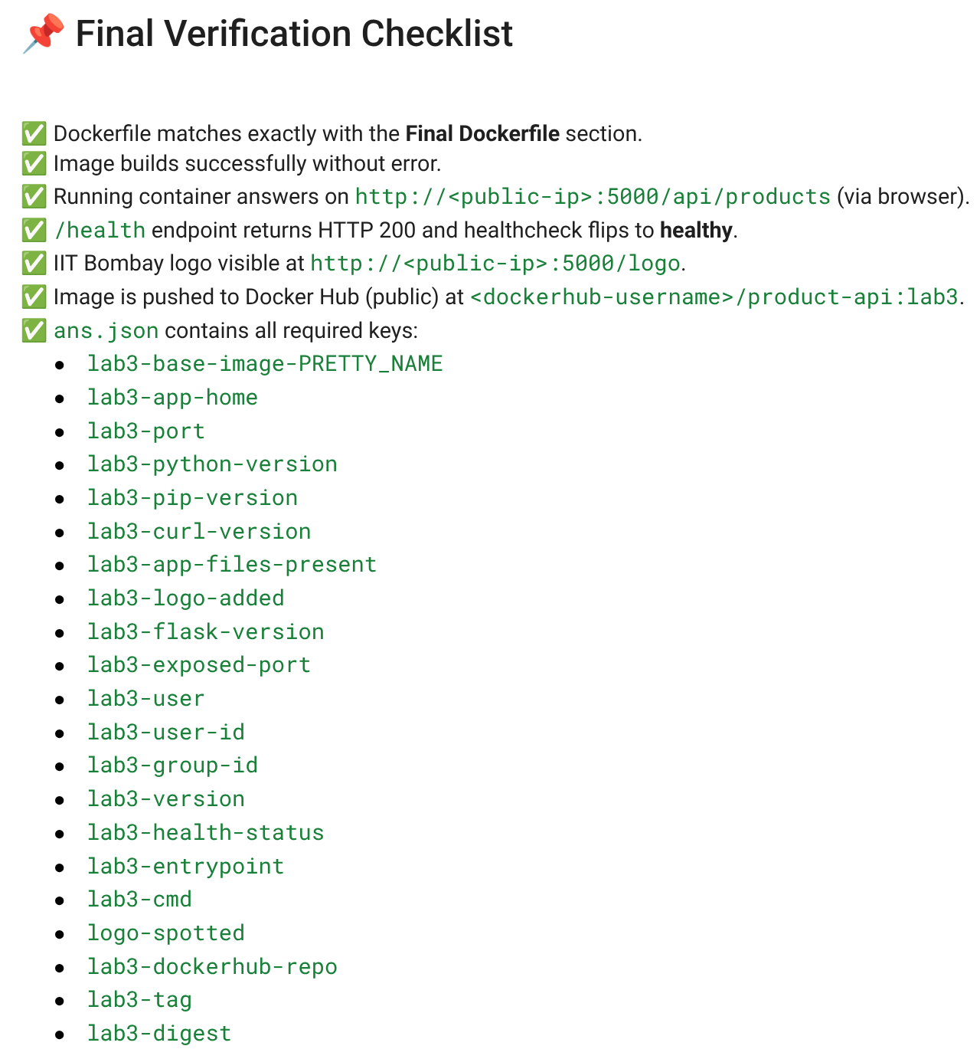
Implementation Challenges
🧩 Implemented Flask app with 4 REST endpoints including GET /health.
⚙️ system-clean-init.sh for clean reproducible setup.
📄 .dockerignore curated to reduce build context size.
🧱 Stepwise Dockerfile (lab3/stepX tags) to demonstrate layer caching.
👤 Non-root user (UID/GID=1001) for secure runtime.
🩺 HEALTHCHECK & /health endpoint integration.
☁️ Push workflow with Docker Hub authentication, tag, and digest validation.

Slide 33
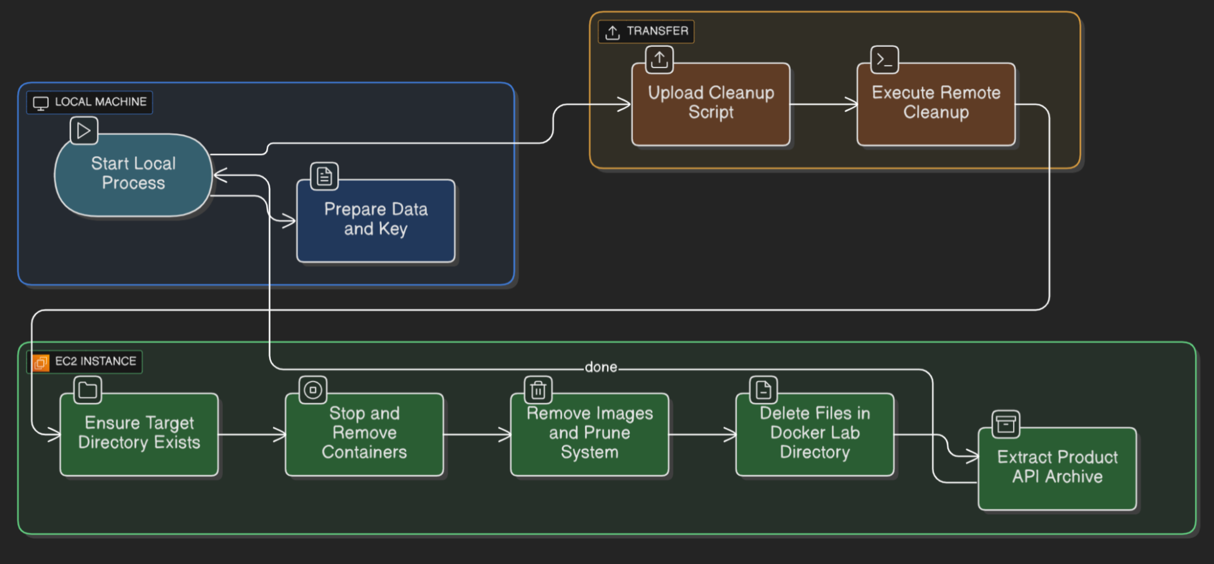
System clean init script

Slide 34
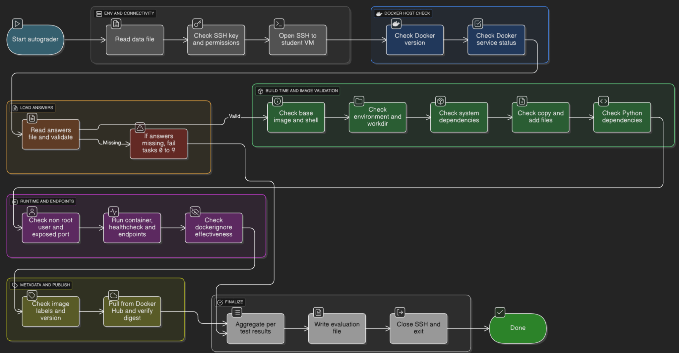
Autograder

Slide 35


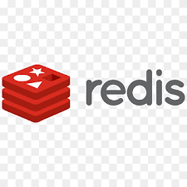
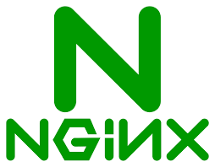
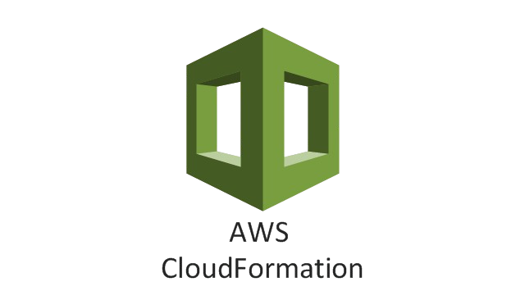
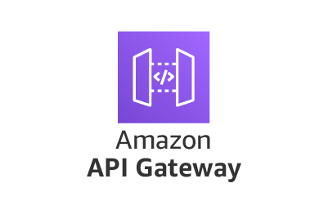

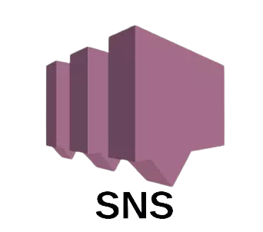

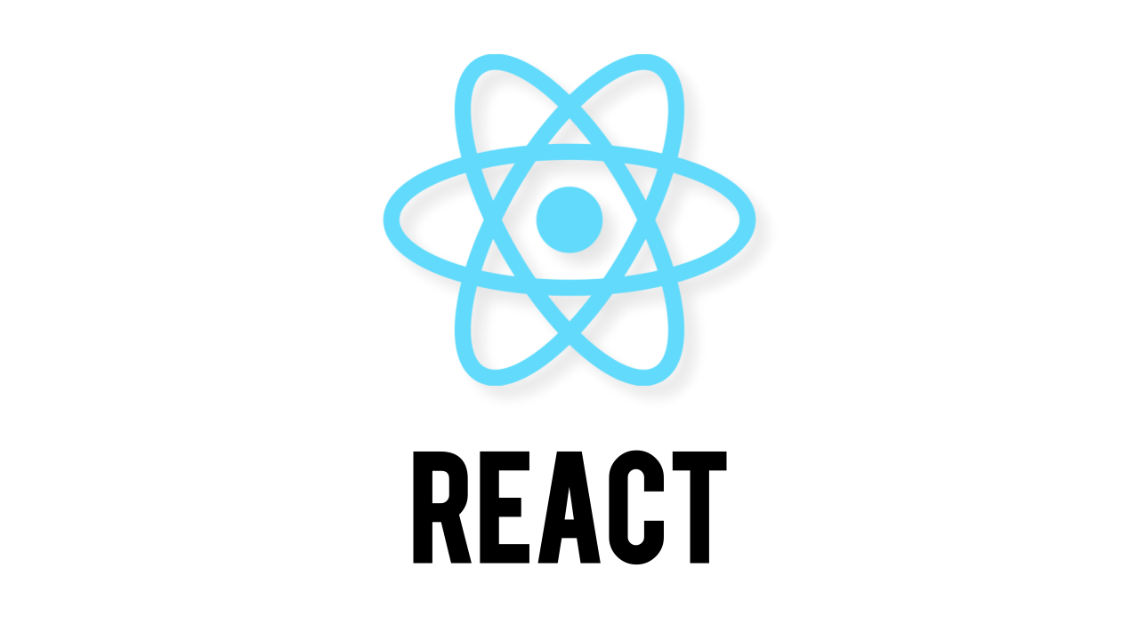
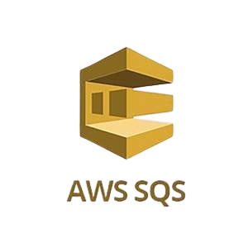
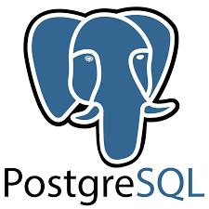
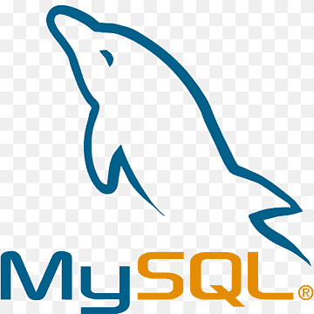
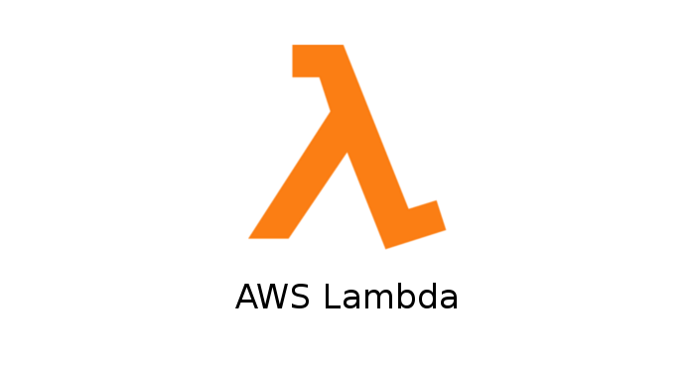

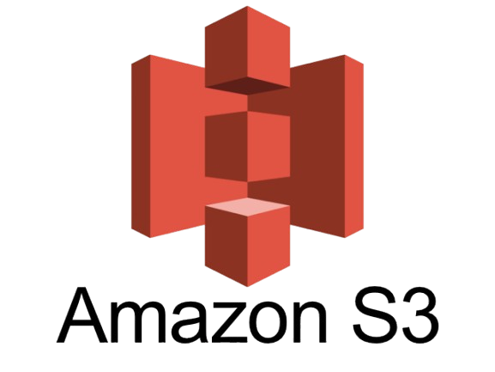
Demo

Slide 36
Activity 4
Networking In Docker (Without Compose)

Slide 37

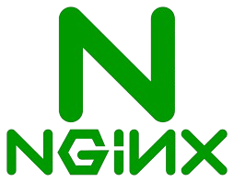
Purpose
🎯To understand Docker's native networking model focusing on service discovery, security.
Compare Network Types: default bridge, user-defined bridge, host, and none network modes.
Manually wire multi-container topologies (no Compose).
Practice service discovery, port publishing, and network inspection.
Run a practical integration: MySQL + phpMyAdmin on a user-defined bridge.

Slide 38
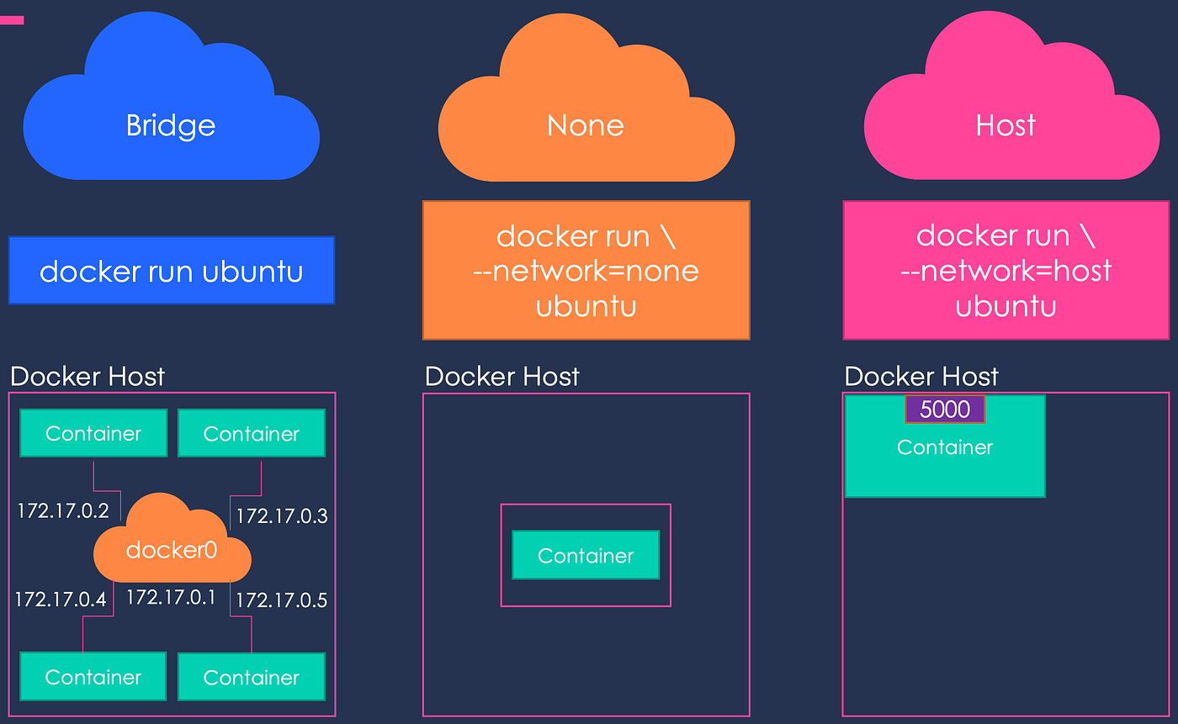
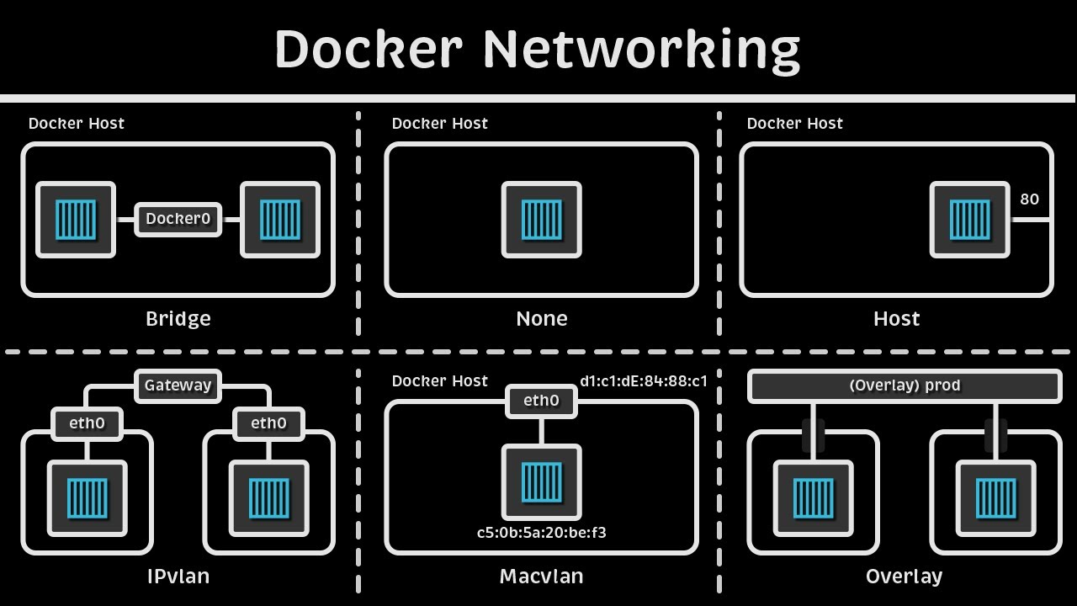
Docker Network
🌉 Bridge:
Connects on a single host. Provides network isolation. service discovery via names.
🌐 Overlay Network:
Connects across multiple hosts.
Creates a distributed network.
🔌 Host Mode:
Shares host’s network interface.
Same IP address.
Use: Lowest latency.
🔒 None Mode:
No network interfaces.
Use: security sandboxes.

Slide 39
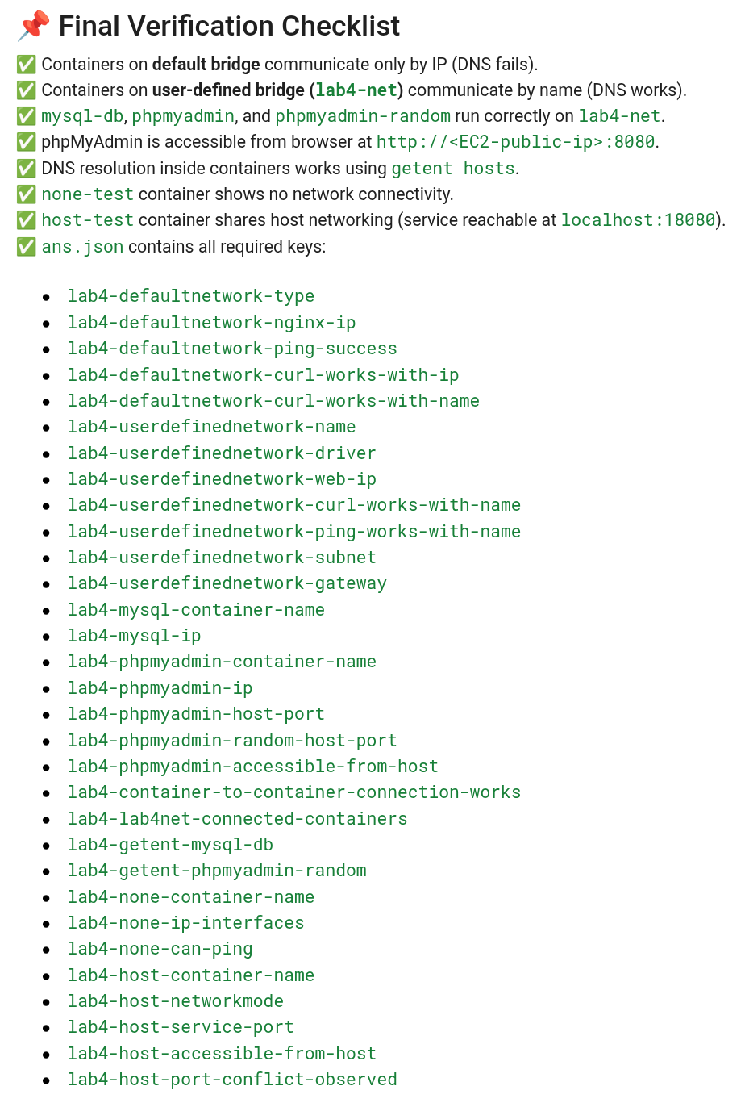
Implementation Challenges
Created a 5 tasks activity
Used nginx and alpine image to Explore the Default Bridge: containers can communicate via IP address only.
Demonstrated creation of user-defined bridge using: docker network create --driver bridge <name>
Demonstrated how direct inter container service discovery can be established using MySQL + phpMyAdmin without exposing ports to the host.
Challenge: Beginner confusion with networks. Solution: stepwise demos and inspection commands.

Slide 40
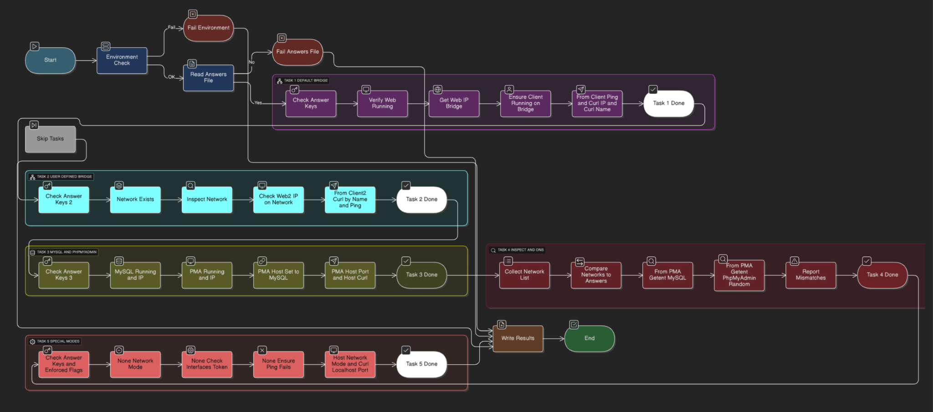
Autograder

Slide 41
Activity 5
Multi-Container Applications with Docker Compose

Slide 42

Purpose
🎯To Learn how Docker Compose orchestrates multi-container apps easily.
Build & deploy a 3-tier course app (React + Spring Boot + PostgreSQL).
Automate networking, startup sequencing, secrets, and scaling.
Produce a production-grade docker-compose.yml from scratch.
Understand depends_on, restart policies, and override files.
Simplify manual steps from Activity 4 into one YAML.

Slide 43


Docker Compose
Declarative Orchestration using .yml files.
Replaces long docker run commands.
Handles container startup order, networking, ports, env vars, and volumes.
One command brings up the entire stack:
docker compose up -d
docker compose down
Built-in network for service-to-service DNS.
Reproducible configuration.
Easier collaboration across envs (dev, prod).

Slide 44


3-Tier Demo App
Frontend (Presentation Tier)
Technology: React.js served by an Nginx web server.
Role: Provides the user interface and communicates with the backend API.
Backend (Logic Tier)
Technology: Spring Boot REST API.
Role: Manages business logic, exposes API endpoints (e.g., /api/courses), and connects to the database.
Database (Data Tier)
Technology: PostgreSQL.
Role: Stores and persists all application data (courses, grades) in a Docker volume.

Slide 45

Implementation Challenges
A 13 tasks activity to construct compose.yml step by step:
User-defined bridge network and Volume setup
External .env substitution
Secure DB password file using secrets
Connect React UI → Backend Spring Boot → Postgres
Robust startup sequencing using depends-on
Auto-recovery : on-failure, unless-stopped
Scaling using compose up --scale
Health-check and Logging drivers setup.

Slide 46

Autograder

Slide 47
Activity 6
Make Dockerfiles Production Ready

Slide 48

Purpose
🎯 To transform a basic, naive Dockerfile into a production-ready version that is significantly smaller, faster to build, and more secure.
Multi-Stage Builds.
Build Caching.
Optimize layer order.
Image Slimming.
Security Hardening
scan for vulnerabilities with trivy.

Slide 49

Optimization Techniques
🏗️ Multi-Stage Builds:
Use a builder stage for compiling and a minimal final stage for running.
copying only the final artifact.
⚡ Cache Mounts (--mount=type=cache):
Use BuildKit to cache package manager dependencies
makes subsequent builds nearly instant.
🪶 Minimal Base Images:
Start the final stage from a tiny base like scratch or distroless
drastically reduces size and vulnerabilities.
🔒 Security Best Practices:
Run final container as non-root (USER 10001)
add a HEALTH-CHECK for reliability.
Staging + distroless runtime
Mount cache
Lighter
healthcheck + non-root
Faster
Secure

Slide 50

Implementation Challenges
Two tasks activity split into: guided example + hands-on exercise.
Part1: Go Worked Example
A step-by-step walkthrough to optimize Dockerfile
Use base image: FROM golang
Apply proper layer order
Apply multi-staging: COPY --from=builder /server /server
Using Trivy for assess vulnerabilities.
Part2: Node.js Exercise (Hands-On)
Create a dockerized Node app
Provide student with a naive Node.js Dockerfile.
Ask student to make it prod-ready.

Slide 51

Autograder

Slide 52
Activity 7
Advanced Docker Concepts (Bonus)

Slide 53

Purpose
🎯 To explore how Docker works under the hood.
Docker Engine & API: How the Docker client talks to the daemon.
Kernel Features: Namespaces for isolation and Cgroups for resource limits.
Storage & Layers: How overlay2 and union filesystems make images efficient.
The OCI Standard: The standards that allow runtimes like Docker, containerd, and runc to interoperate.
Modern Tooling: Rootless Docker for security and docker init for project scaffolding.

Slide 54
Project Outline
About Docker
Docker Labs
About Serverless Framework
Serverless Labs
Activity
0
Activity
1
Activity
7
Activity
1
Activity
4

Slide 55

About Serverless Framework

Slide 56

What is Serverless Computing?
No Server Management.
Event-Driven Execution: Functions run only when triggered (e.g. HTTP, S3).
Automatic Provisioning, Scaling, Patching: instantly based on load.
Pay-per-Use: Billed only for actual compute time, not idle servers.
Examples: AWS Lambda, Azure Functions, Google Cloud Functions
In essence Serverless = Focus on functions, not servers.

Slide 57


What is Serverless Framework?
Open-source toolkit for building, deploying, and managing Serverless Applications.
Works across AWS, Azure, Google Cloud.
Entire application - functions, events, and resources are defined in a single declarative file: serverless.yml. The framework handles the rest.
It abstracts away complexity of cloud infrastructure. Developers focus on writing logic.
⚡ Faster Deployments
Enhanced Observability & Local Testing
Productivity & portability across clouds

Slide 58

Serverless Framework v4 Architecture
Core Components
Serverless CLI: init, deploy, invoke functions.
serverless.yml: declarative config.
Providers & Plugins: extended modules.
Serverless Dashboard: monitoring.
Deployment Workflow
Parse & validate serverless.yml.
Package functions + deps into ZIP files.
Generate native IaC template: CloudFormation
Upload artifacts to storage e.g. S3 → deploy.
Track state for rollbacks & incremental updates.
Declarative IaC → Automated Deployment → Observable Runtime.

Slide 59
Project Outline
About Docker
Docker Labs
About Serverless Framework
Serverless Labs
Activity
0
Activity
1
Activity
7
Activity
1
Activity
4

Slide 60

Serverless
Framework Labs

Slide 61
Activity 1
Environment Setup

Slide 62

Purpose
🎯To prepare a consistent baseline local + cloud environment for Serverless Framework development on AWS.
Configure AWS IAM user with programmatic access.
Set up AWS CLI (profile: serverless-lab).
Install Python ≥ 3.9 for Lambda runtime.
Install Node.js (LTS) + Serverless CLI via npm.
Serverless Framework CLI installed and authenticated with Serverless Dashboard.

Slide 63

Challenges & Solutions
Challenge: Credential Misconfiguration 🔑
Problem: Mistyping access keys or regions.
Solution: Includes a mandatory verification step using aws sts get-caller-identity to immediately confirm if credentials are working.
Challenge: Version Mismatches ⚙️
Problem: Incompatible versions of Node.js.
Solution: The lab uses nvm (Node Version Manager) to ensure a stable, long-term support (LTS) version.
Challenge: Ephemeral Lab Environment ⏳
Problem: Lab environment resets after each session, causing progress to be lost.
Solution: Explicit warning about the ephemeral nature. A cleanup script to ensure a start from clean state.

Slide 64
Activity 2
Serverless Framework v4 Core Concepts

Slide 65





Purpose
cLab CLI
serverless.yml
CLI
🎯To master the serverless.yml language of the Serverless Framework v4.
Learn the essential keywords like service, provider, functions, events, and resources.
Master the CLI: commands like package, deploy, invoke, invoke local, logs, info, and remove.
Install/use essential plugins and inspect generated CloudFormation.
See how your simple YAML configuration is translated into a powerful AWS CloudFormation stack.
IaC
packaging
CloudFormation stack

Slide 66


Challenges & Solutions
Problem:
Manual setup leads to inconsistency across student machines.
Solution:
Provided a unified CLAB base Docker image, pre-installing all necessary tools (AWS CLI, Node.js, Python, Serverless Framework).
Provides consistent, ready-to-use env.
Problem:
It's often unclear how code gets to AWS.
Solution:
Walkthrough full Deployment Lifecycle: including role of S3 deployment bucket, as the bridge to CloudFormation.
Conceptual Reinforcement:
A BodhiTree quiz is developed to test and solidify understanding of the core concepts.
Dockerfile

Slide 67
Activity 3
Building a Serverless Application (Hand-held)

Slide 68

Purpose
🎯To build a complete, multi-service serverless application. It's a "hand-held" lab.
Create & deploy Lambda functions behind APIGateway (hello, createTodo, publishMessage).
Provision DynamoDB, SQS, SNS and wire SNS→SQS→Lambda.
Implement Infrastructure-as-Code: Define and deploy entire cloud stack using a single serverless.yml file.
Attach least-privilege IAM roles and inspect the generated CloudFormation.

Slide 69

Implementation Challenges
IAM
Problem: Writing a complex serverless.yml from scratch is overwhelming.
Solution: Provided a pre-built project skeleton with functions and templates.
Problem: Access Denied errors.
Solution: Included pre-written, least-privilege IAM role setup IaC.
Problem: Different local tool versions can lead to failures and difficult to debug.
Solution: Unified cLab base Docker image.
Conceptual Reinforcement: short formative BodhiTree quiz.

Slide 70
Activity 4
Exercise: Image Processing Pipeline

Slide 71

Purpose
🎯To let students independently build and deploy a real-world, event-driven image processing application.
Trigger: An image is uploaded to S3 bucket.
Process:
Lambda function imageProcessor resizes image, saves metadata to DynamoDB JobsTable, and publishes a notification to SNS.
A second Lambda function analyticsLogger, triggered by SNS, writes analytics data to another S3 bucket.
All logs are logged by CloudWatcher.

Slide 72

Implementation Challenges
Challenge: Students lose all progress if their lab session ended.
Solution: The student workspace root is now mounted to a persistent Docker volume, ensuring all files and configurations are saved between sessions.
Challenge: Running Docker-in-Docker for Serverless framework Plugins
Solution: The lab container is configured to run with the --privileged flag.
Challenge: Dependency and Version Conflicts
Solution: The lab uses a unified base image with all required tools (Node.js, Python, AWS CLI) pre-installed.

Slide 73

Autograder

Slide 74
Project Outline
About Docker
Docker Labs
About Serverless Framework
Serverless Labs
Activity
0
Activity
1
Activity
7
Activity
1
Activity
4

Slide 75
Demo

Slide 76

THANK YOU

